Slide 1
BAYESIAN LEARNING FOR NEURAL NETWORK
Venkata Kanuparthi 1729564
Naren Chandra Ambati 1733709
Sampath goud bairu 1724548

Slide 2
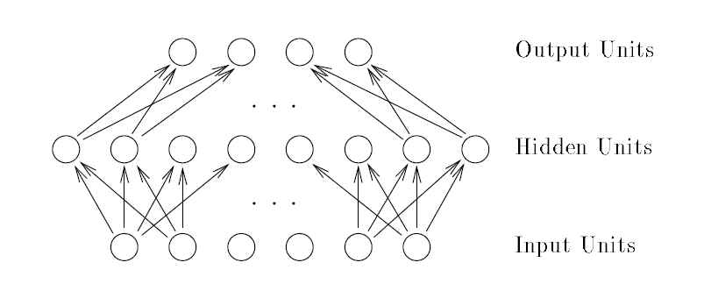
Artificial Neural Network

Slide 3
Problems
Training data is limited
Excessively complex model
Overfitting – too many parameters

Slide 4
Solution
Purpose – predicting the output
Bayesian methods
Practical use – Markov Chain Monte Carlo techniques

Slide 5
Markov Chain Monte Carlo (MCMC)
Class of algorithms for sampling from probability distributions
Constructing a Markov Chain (MC)
MC evolves until it reaches equilibrium

Slide 6
Markov Chain
A dependent sequence of random variables
Next step or iteration of the process only depends upon the current step
Process evolves in a randomly fashion
Reaches a certain state where it remains thereafter, Equilibrium

Slide 7
Random Walk MCMC
Simplest MCMC algorithms are random walks
Each step in the algorithm takes small, random steps
Key issue – how these steps are defined and how to minimize the steps
No specific answer. But different algorithms exist – different ways of sampling
Random walk Metropolis, Metropolis-Hastings, Independence Sampler, Gibbs Sampler

Slide 8
MCMC Simulation
A dependent sequence of random variables, {θ(i) } i=1 to M, with approximate distribution,
p(θ(i) ) ≈ p(θ|y)
The chain is initialized with a user defined starting value, θ (0)
The Markov property then specifies that the distribution of θ(i+1) | θ(0), θ(1),…., θ(i) depends only on the current state of the chain θ (i)

Slide 9
MCMC Simulation
A Markov chain is specified by its transition kernel defined as,
P(θ (i) , A) = _{def} P(θ(i+1) ∈ A|θ(i) )
for any set A ∈ Θ, which specifies the conditional distribution of θ(i+1) given the current state θ(i)
Transition kernel - mapping of the transition matrix
The n-step transition kernel is,
P^{n}(θ(0), A) =_{def} P(θ(n) ∈ A|θ(0))

Slide 10
THANK YOU

